Slide 1

CMake Practice
Bing Han Lin

Slide 2
Why Cmake
workflow
Hello world case
Practice cases
Implement in our code
https://stackoverflow.com/questions/25789644/difference-between-using-makefile-and-cmake-to-compile-the-code

Slide 3
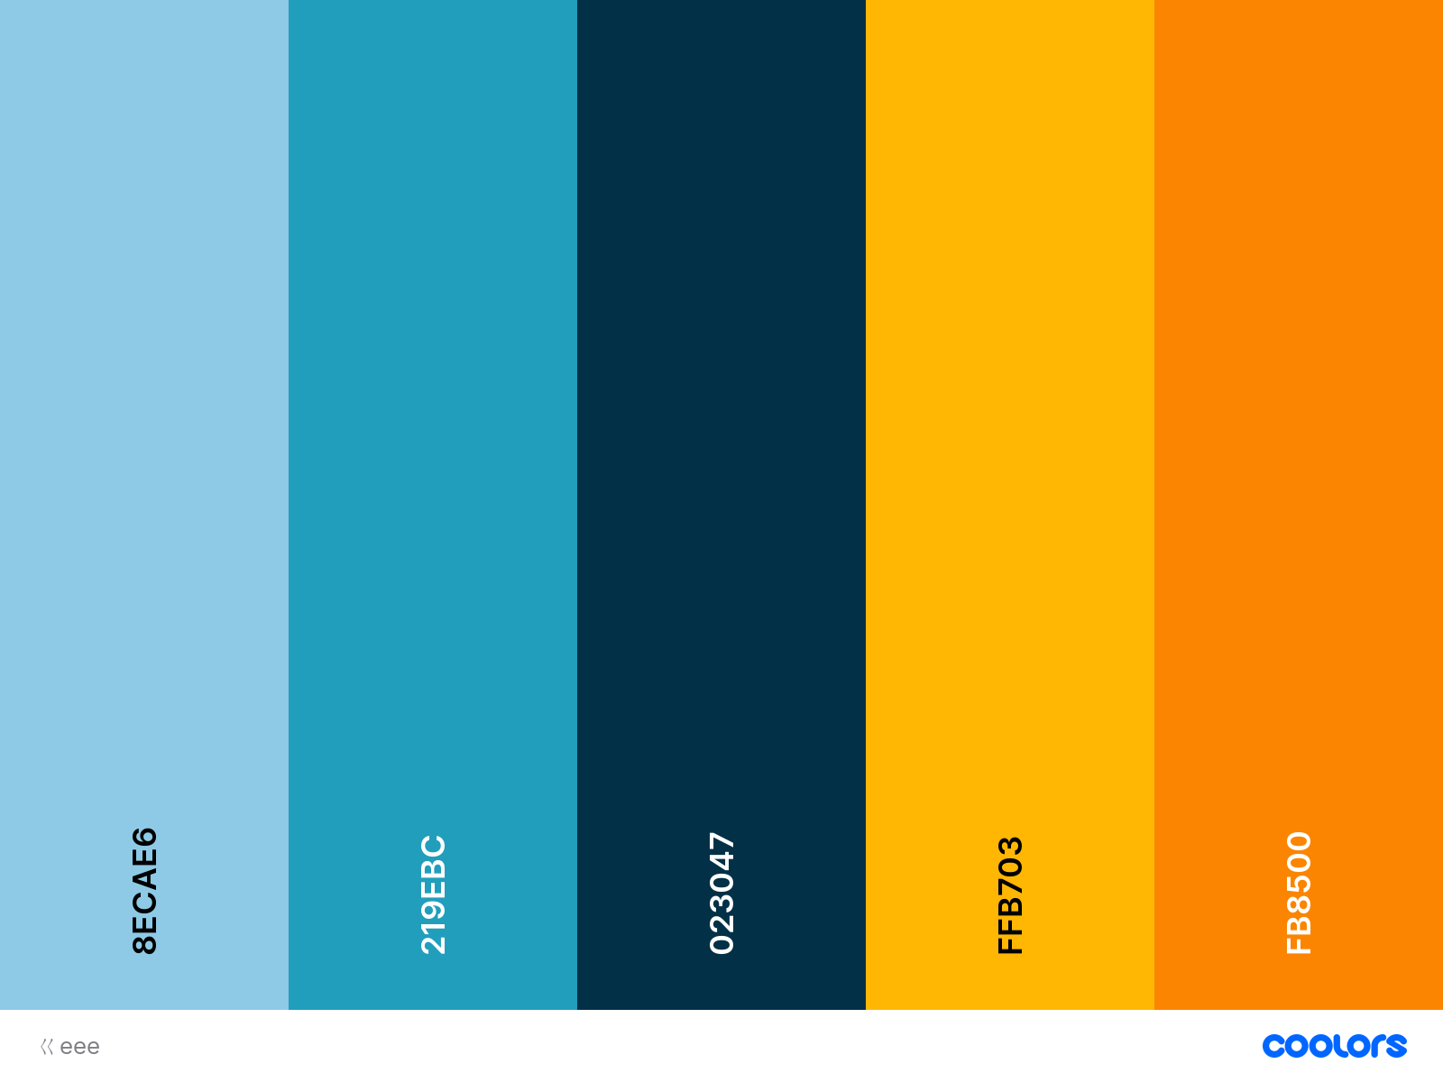
Why/What CMake
+ boo.cpp
CMakeLists.txt
CMake
+ boo.cpp
Generator of build systems
Makefile
Visual Studio
Xcode
Makefile
Visual Studio
Xcode
binaries
binaries
Notes:
https://stackoverflow.com/questions/25789644/difference-between-using-makefile-and-cmake-to-compile-the-code

Slide 4
CMake Workflow
CMake
Native Build Tools
CTest
CPack
Build System Generation
Build
Test
Package
Configure
Generate
https://cgold.readthedocs.io/en/latest/overview/cmake-can.html
Notes:
https://cgold.readthedocs.io/en/latest/overview/cmake-can.html

Slide 5
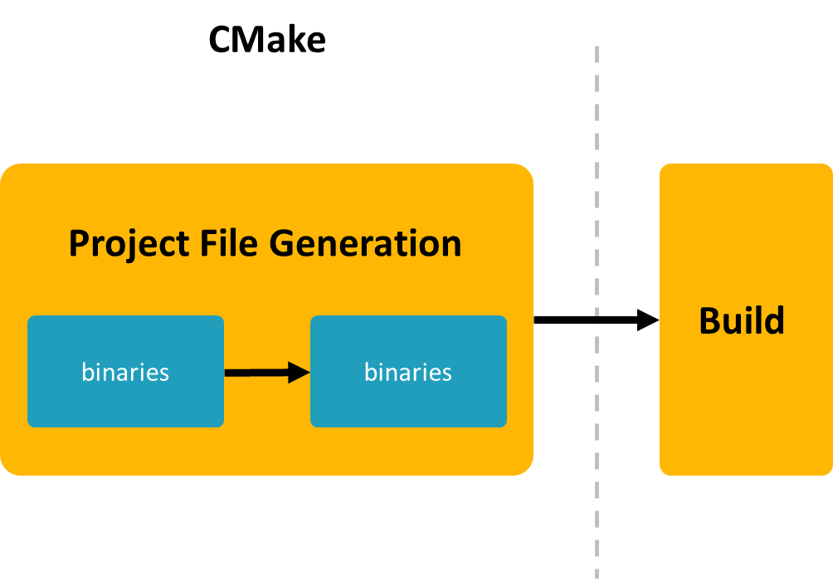
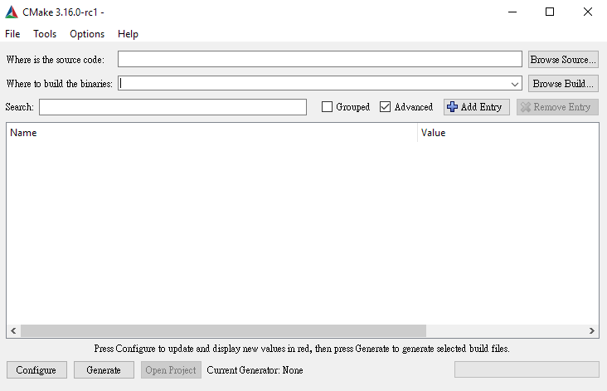
CMake Build Workflow
Generate a Project Build System:
> cmake …
Build a Project
> cmake --build …
Install a Project
> cmake --install …
Notes:
Cmake/help/latest/manual/cmake.1.html

Slide 6
How to write a
CMakeLists.txt?

Slide 7
CMake Language (1) Variables
> cmake …
Variables are always string type.
Variable names are case-sensitive.
Reserves variable
Variable names are case-sensitive
Notes:
https://stackoverflow.com/questions/31037882/whats-the-cmake-syntax-to-set-and-use-variables

Slide 8
CMake Language (1) Variable Scope
Function Scope
Directory Scope
https://preshing.com/20170522/learn-cmakes-scripting-language-in-15-minutes/
Directories
script
module

Slide 9
CMake Language (2) Targets & Properties

Slide 10
CMake Language (3) Others
message
If statement
Function
Macros

Slide 11
CMake Organization
Directories
script
module

Slide 12
CMake Example
Source & binary directory
Build Configuration
Generrator type msvc mingw
Notes:
https://www.slideshare.net/oliora/introduction-to-cmake-in-30-minutes
https://www.slideshare.net/DanielPfeifer1/cmake-48475415
https://myslide.cn/slides/12169
https://zh.wikibooks.org/wiki/CMake_%E5%85%A5%E9%96%80/%E8%BC%B8%E5%87%BA%E4%BD%8D%E7%BD%AE%E8%88%87%E5%AE%89%E8%A3%9D

